Slide 1
KUBERNETES FAILURE PREDICTION
Phase 1 Report
GW Devtrails Hackathon

Slide 2

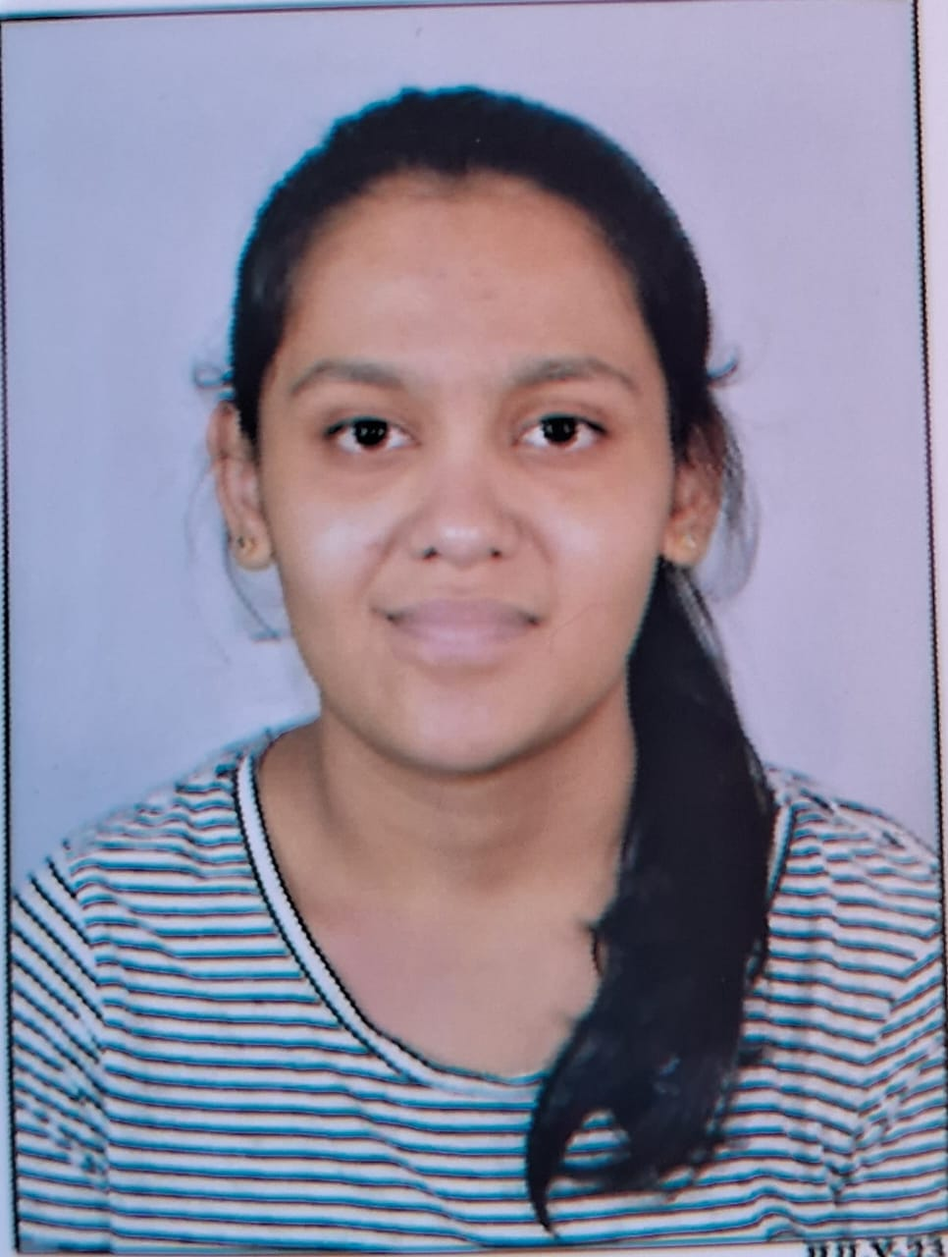
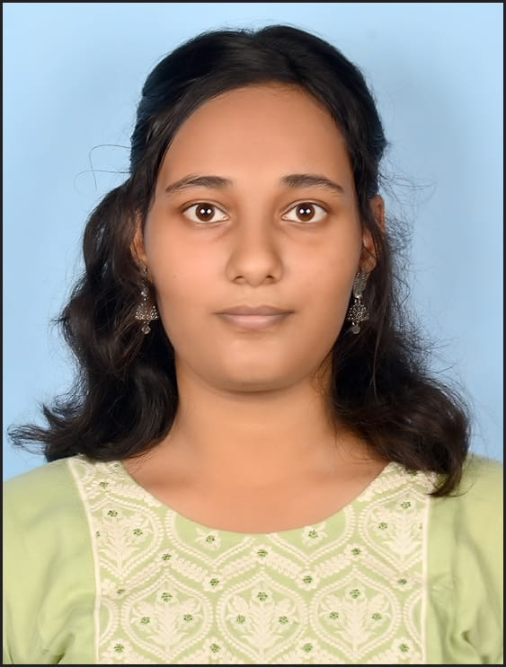

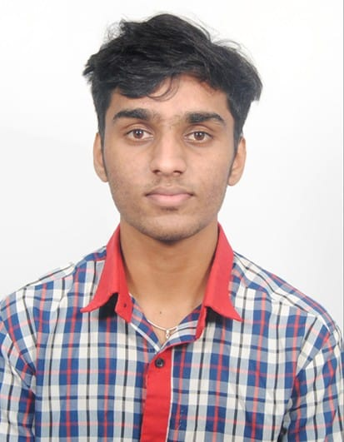
Team Members
Sunny sz8158@srmist.edu.in
Prachi Singhal
ps7514@srmist.edu.in
Tanvi Goel
tg2284@srmist.edu.in
Abhimanyu Singh Mandlawat
am2886@srmist.edu.in
Vineet Banashankari
vb3306@srmist.edu.in

Slide 3
Introduction
Kubernetes clusters experience failures due to:
- Pod crashes
- Resource exhaustion (CPU, Memory, Disk)
- Network bottlenecks
Our goal: Build an AI/ML model to predict failures before they happen.

Slide 4
Dataset Overview
Dataset contains 100,000 records of Kubernetes system metrics.
Main features include:
- CPU Usage (%)
- Memory Usage (%)
- Disk Usage (%)
- Network I/O (MB/s)
- Error Logs Count
- Pod Status (Categorical)
View Dataset

Slide 5
Data Preprocessing
Step | Description
Dropped Timestamp | Removed unnecessary time column
Encoded Pod Status | Converted categorical data to numerical
Standardized Data | Normalized CPU, Memory, and Disk usage
Balanced Data | Applied SMOTE to handle class imbalance

Slide 6
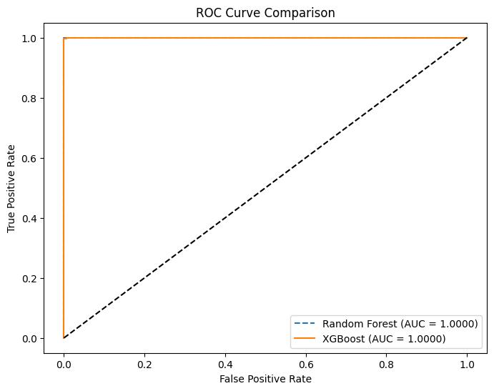
Model Development
We trained two models:
1. Random Forest Classifier - Tuned with RandomizedSearchCV, achieved 99.95% accuracy.
2. XGBoost Classifier- Trained on balanced data, achieved 99.75% accuracy.

Slide 7
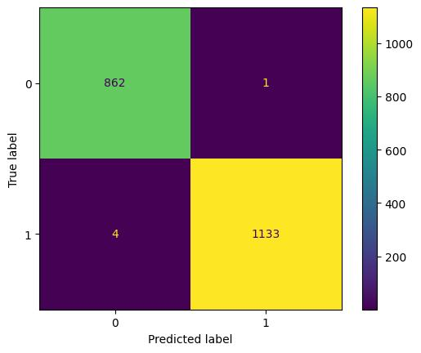

Vs
XG Boost
Random Forest

Slide 8
Model Evaluation
Model | Accuracy | Precision | Recall | F1-Score
Random Forest | 99.95% | 1.00 | 1.00 | 1.00
XGBoost | 99.75% | 1.00 | 1.00 | 1.00

Slide 9
Testing on New Data (2,000 records)
Model | Accuracy | Precision | Recall | F1-Score
Random Forest | 98.80% | 99% | 99% | 99%
XGBoost | 93.30% | 94% | 93% | 93%

Slide 10
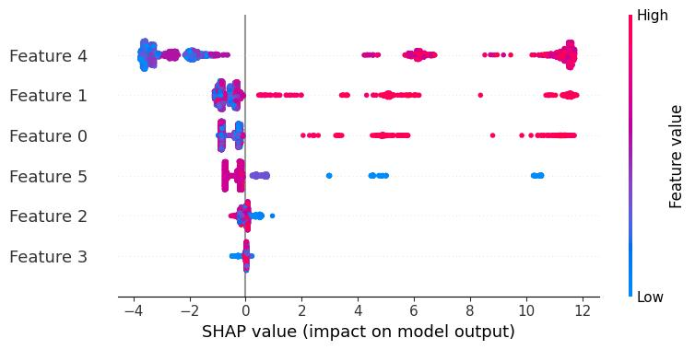
Model Deployment
Trained models were saved as `.pkl` files for deployment.
Feature importance analysis was conducted using SHAP values.
Random Forest
SHAP Values
XG Boost

Slide 11
Conclusion
We successfully developed an AI/ML model to predict Kubernetes failures.
Random Forest achieved 98.8% accuracy and generalizes well.
XGBoost provides a more aggressive failure prediction approach.
Next Steps: Deploy the model and integrate AI-driven alerts.

